Slide 1
Data and Computer Communications
Chapter 13
Wireless Communications
MIS420
Carlo Moubarak
Sagesse University
2019

Slide 2
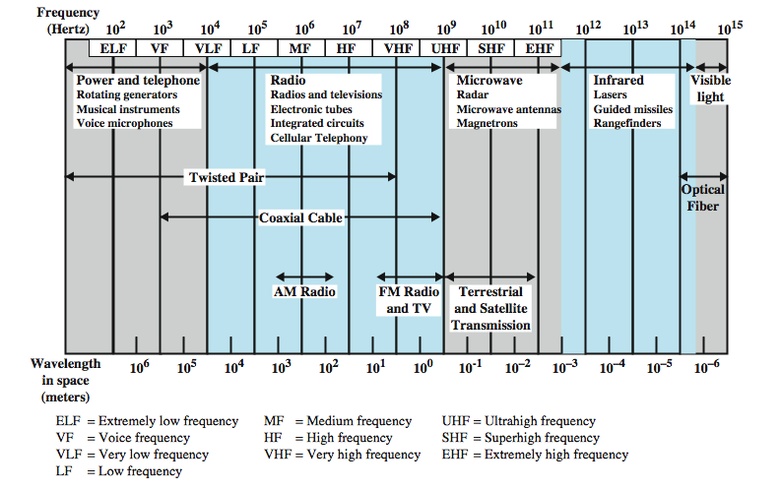
Electromagnetic Spectrum
Notes:
Figure 4.1 depicts the electromagnetic spectrum and indicates the frequencies at which various guided media and unguided transmission techniques operate. In this chapter we examine these guided and unguided alternatives. In all cases, we describe the systems physically, briefly discuss applications, and summarize key transmission characteristics.

Slide 3
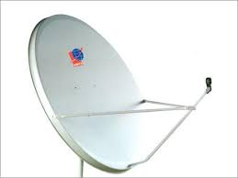
Wireless Transmission Frequencies
2GHz to 40GHz
  microwave
  highly directional
  point to point
  satellite
30MHz to 1GHz
  omnidirectional
  broadcast radio
3 x 10¹¹ to 2 x 10¹⁴
  infrared
  local
Notes:
Unguided transmission techniques commonly used for information communications include broadcast radio, terrestrial microwave, and satellite. Infrared transmission is used in some LAN applications. Three general ranges of frequencies are of interest in our discussion of wireless transmission.
Frequencies in the range of about 1 to 40 GHz are referred to as microwave frequencies. At these frequencies, highly directional beams are possible, and microwave is quite suitable for point-to-point transmission. Microwave is also used for satellite communications.
Frequencies in the range of 30 MHz to 1 GHz are suitable for omnidirectional applications. We refer to this range as the radio range.
Another important frequency range is the infrared portion of the spectrum, roughly from 3 × 10¹¹ to 2 × 10¹⁴ Hz. Infrared is useful to local point-to-point and multipoint applications within confined areas, such as a single room.

Slide 4
Antennas
electrical conductor used to radiate or collect electromagnetic energy
transmission antenna
  radio frequency energy from transmitter
  converted to electromagnetic energy by antenna
  radiated into surrounding environment
reception antenna
  electromagnetic energy impinging on antenna
  converted to radio frequency electrical energy
  fed to receiver
same antenna is often used for both purposes
Notes:
For unguided media, transmission and reception are achieved by means of an antenna. An antenna can be defined as an electrical conductor or system of conductors used either for radiating electromagnetic energy or for collecting electromagnetic energy.
For transmission of a signal, radio-frequency electrical energy from the transmitter is converted into electromagnetic energy by the antenna and radiated into the surrounding environment.
For reception of a signal, electromagnetic energy impinging on the antenna is converted into radio-frequency electrical energy and fed into the receiver.
In two-way communication, the same antenna can be and often is used for both transmission and reception. This is possible because antenna characteristics are essentially the same whether an antenna is sending or receiving electromagnetic energy.

Slide 5
Radiation Pattern
power radiated in all directions
not same performance in all directions
  as seen in a radiation pattern diagram
an isotropic antenna is a (theoretical) point in space
  radiates in all directions equally
  with a spherical radiation pattern
Notes:
An antenna will radiate power in all directions but, typically, does not perform equally well in all directions. A common way to characterize the performance of an antenna is the radiation pattern, which is a graphical representation of the radiation properties of an antenna as a function of space coordinates.
The simplest pattern is produced by an idealized antenna known as the isotropic antenna. An isotropic antenna is a point in space that radiates power in all directions equally. The actual radiation pattern for the isotropic antenna is a sphere with the antenna at the center.

Slide 6
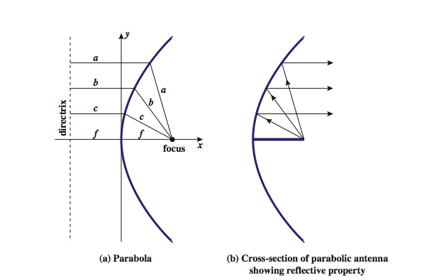
Parabolic Reflective Antenna
Notes:
An important type of antenna is the parabolic reflective antenna, which is used in terrestrial microwave and satellite applications. A parabola is the locus of all points equidistant from a fixed line (the directrix) and a fixed point (the focus) not on the line, as shown in Stallings DCC8e Figure 4.5a above. If a parabola is revolved about its axis, the surface generated is called a paraboloid.
Paraboloid surfaces are used in headlights, optical and radio telescopes, and microwave antennas because: If a source of electromagnetic energy (or sound) is placed at the focus of the paraboloid, and if the paraboloid is a reflecting surface, then the wave will bounce back in lines parallel to the axis of the paraboloid; as shown in Stallings DCC8e Figure 4.5b above. In theory, this effect creates a parallel beam without dispersion. In practice, there will be some dispersion, because the source of energy must occupy more than one point. The larger the diameter of the antenna, the more tightly directional is the beam. On reception, if incoming waves are parallel to the axis of the reflecting paraboloid, the resulting signal will be concentrated at the focus.

Slide 7
Antenna Gain
measure of directionality of antenna
power output in particular direction verses that produced by an isotropic antenna
measured in decibels (dB)
results in loss in power in another direction
effective area relates to size and shape
  related to gain
Notes:
Antenna gain is a measure of the directionality of an antenna. Antenna gain is defined as the power output, in a particular direction, compared to that produced in any direction by a perfect omnidirectional antenna (isotropic antenna). For example, if an antenna has a gain of 3 dB, that antenna improves upon the isotropic antenna in that direction by 3 dB, or a factor of 2. The increased power radiated in a given direction is at the expense of other directions. In effect, increased power is radiated in one direction by reducing the power radiated in other directions. It is important to note that antenna gain does not refer to obtaining more output power than input power but rather to directionality.
A concept related to that of antenna gain is the effective area of an antenna. The effective area of an antenna is related to the physical size of the antenna and to its shape, as shown in equation 4.1.

Slide 8
Terrestrial Microwave
used for long haul telecommunications
and short point-to-point links
requires fewer repeaters but line of sight
use a parabolic dish to focus a narrow beam onto a receiver antenna
1-40GHz frequencies
higher frequencies give higher data rates
main source of loss is attenuation
  distance, rainfall
also interference
Notes:
The primary use for terrestrial microwave systems is in long haul telecommunications service, as an alternative to coaxial cable or optical fiber. The microwave facility requires far fewer amplifiers or repeaters than coaxial cable over the same distance, (typically every 10-100 km) but requires line-of-sight transmission. Microwave is commonly used for both voice and television transmission. Another increasingly common use of microwave is for short point-to-point links between buildings, for closed-circuit TV or as a data link between local area networks.
The most common type of microwave antenna is the parabolic "dish”, fixed rigidly to focus a narrow beam on a receiving antenna A typical size is about 3 m in diameter. Microwave antennas are usually located at substantial heights above ground level to extend the range between antennas and to be able to transmit over intervening obstacles. To achieve long-distance transmission, a series of microwave relay towers is used, and point-to-point microwave links are strung together over the desired distance.
Microwave transmission covers a substantial portion of the electromagnetic spectrum, typically in the range 1 to 40 GHz, with 4-6GHz and now 11GHz bands the most common. The higher the frequency used, the higher the potential bandwidth and therefore the higher the potential data rate. As with any transmission system, a main source of loss is attenuation, related to the square of distance. The effects of rainfall become especially noticeable above 10 GHz. Another source of impairment is interference.

Slide 9
Satellite Microwave
satellite is relay station
receives on one frequency, amplifies or repeats signal and transmits on another frequency
  eg. uplink 5.925-6.425 GHz & downlink 3.7-4.2 GHz
typically requires geo-stationary orbit
  height of 35,784km
  spaced at least 3-4° apart
typical uses
  television
  long distance telephone
  private business networks
  global positioning
Notes:
A communication satellite is, in effect, a microwave relay station. It is used to link two or more ground-based microwave transmitter/receivers, known as earth stations, or ground stations. The satellite receives transmissions on one frequency band (uplink), amplifies or repeats the signal, and transmits it on another frequency (downlink). A single orbiting satellite will operate on a number of frequency bands, called transponder channels, or simply transponders. The optimum frequency range for satellite transmission is in the range 1 to 10 GHz. Most satellites providing point-to-point service today use a frequency bandwidth in the range 5.925 to 6.425 GHz for transmission from earth to satellite (uplink) and a bandwidth in the range 3.7 to 4.2 GHz for transmission from satellite to earth (downlink). This combination is referred to as the 4/6-GHz band, but has become saturated. So the 12/14-GHz band has been developed (uplink: 14 - 14.5 GHz; downlink: 11.7 - 12.2 GHz).
For a communication satellite to function effectively, it is generally required that it remain stationary with respect to its position over the earth to be within the line of sight of its earth stations at all times. To remain stationary, the satellite must have a period of rotation equal to the earth's period of rotation, which occurs at a height of 35,863 km at the equator. Two satellites using the same frequency band, if close enough together, will interfere with each other. To avoid this, current standards require a 4° spacing in the 4/6-GHz band and a 3° spacing at 12/14 GHz. Thus the number of possible satellites is quite limited.
Among the most important applications for satellites are: Television distribution, Long-distance telephone transmission, Private business networks, and Global positioning.

Slide 10
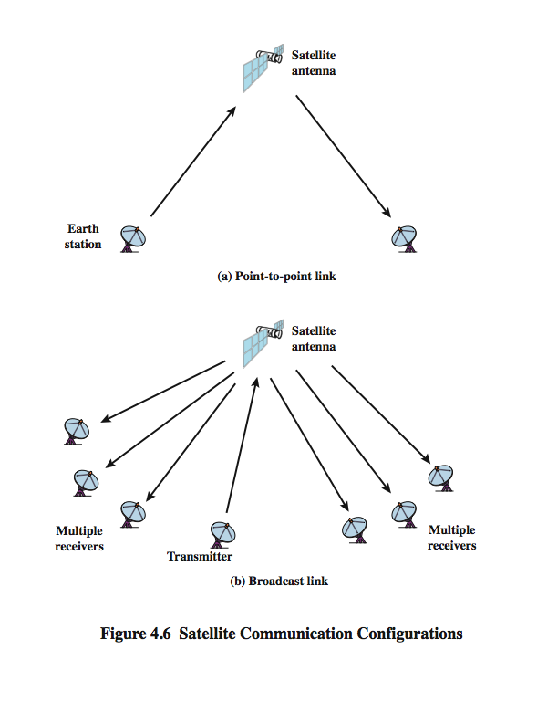
Satellite Point to Point Link
Notes:
Stallings DCC8e Figure 4.6 depicts in a general way two common configurations for satellite communication. In the first, the satellite is being used to provide a point-to-point link between two distant ground-based antennas.

Slide 11
Satellite Broadcast Link
Notes:
Stallings DCC8e Figure 4.6 depicts in a general way two common configurations for satellite communication. In the second, the satellite provides communications between one ground-based transmitter and a number of ground-based receivers.

Slide 12
Broadcast Radio
radio is 3kHz to 300GHz
use broadcast radio, 30MHz - 1GHz, for:
  FM radio
  UHF and VHF television
is omnidirectional
still need line of sight
suffers from multipath interference
  reflections from land, water, other objects
Notes:
Radio is a general term used to encompass frequencies in the range of 3 kHz to 300 GHz. We are using the informal term broadcast radio to cover the VHF and part of the UHF band: 30 MHz to 1 GHz. This range covers FM radio and UHF and VHF television. This range is also used for a number of data networking applications. The principal difference between broadcast radio and microwave is that the former is omnidirectional and the latter is directional. Thus broadcast radio does not require dish-shaped antennas, and the antennas need not be rigidly mounted to a precise alignment.
The range 30 MHz to 1 GHz is an effective one for broadcast communications. Unlike the case for lower-frequency electromagnetic waves, the ionosphere is transparent to radio waves above 30 MHz. Thus transmission is limited to the line of sight, and distant transmitters will not interfere with each other due to reflection from the atmosphere. Unlike the higher frequencies of the microwave region, broadcast radio waves are less sensitive to attenuation from rainfall. A prime source of impairment for broadcast radio waves is multipath interference. Reflection from land, water, and natural or human-made objects can create multiple paths between antennas, eg ghosting on TV pictures.

Slide 13
Infrared
modulate noncoherent infrared light
end line of sight (or reflection)
are blocked by walls
no licenses required
typical uses
  TV remote control
  IRD port
Notes:
Infrared communications is achieved using transmitters/receivers (transceivers) that modulate noncoherent infrared light. Transceivers must be within the line of sight of each other either directly or via reflection from a light-colored surface such as the ceiling of a room.
One important difference between infrared and microwave transmission is that the former does not penetrate walls. Thus the security and interference problems encountered in microwave systems are not present. Furthermore, there is no frequency allocation issue with infrared, because no licensing is required.

Slide 14
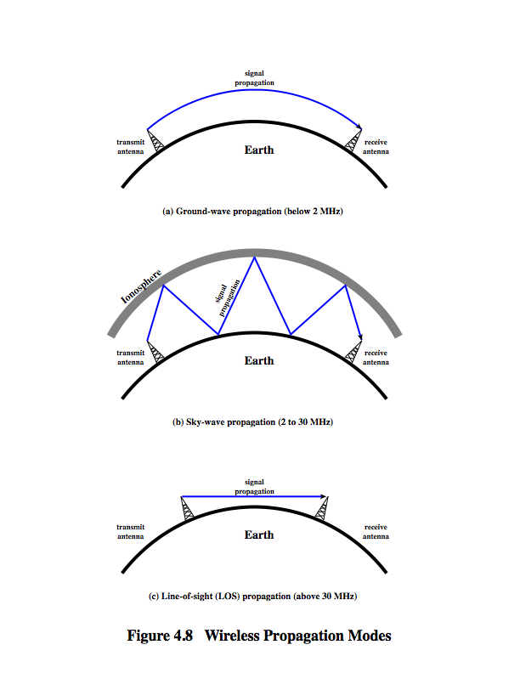
Wireless Propagation
Ground Wave
Notes:
A signal radiated from an antenna travels along one of three routes: ground wave, sky wave, or line of sight (LOS), as shown in Stallings DCC8e Figure 4.8.
Ground wave propagation more or less follows the contour of the earth and can propagate considerable distances, well over the visual horizon. This effect is found in frequencies up to about 2 MHz. Several factors account for the tendency of electromagnetic wave in this frequency band to follow the earth's curvature. One factor is that the electromagnetic wave induces a current in the earth's surface, the result of which is to slow the wavefront near the earth, causing the wavefront to tilt downward and hence follow the earth's curvature. Another factor is diffraction, which is a phenomenon having to do with the behavior of electromagnetic waves in the presence of obstacles. Electromagnetic waves in this frequency range are scattered by the atmosphere in such a way that they do not penetrate the upper atmosphere. The best-known example of ground wave communication is AM radio.

Slide 15
Wireless Propagation
Sky Wave
Notes:
Sky wave propagation is used for amateur radio, CB radio, and international broadcasts such as BBC and Voice of America. With sky wave propagation, a signal from an earth-based antenna is reflected from the ionized layer of the upper atmosphere (ionosphere) back down to earth. Although it appears the wave is reflected from the ionosphere as if the ionosphere were a hard reflecting surface, the effect is in fact caused by refraction. Refraction is described subsequently. A sky wave signal can travel through a number of hops, bouncing back and forth between the ionosphere and the earth's surface, as shown in Stallings DCC8e Figure 4.8b. With this propagation mode, a signal can be picked up thousands of kilometers from the transmitter.

Slide 16
Wireless Propagation
Line of Sight
Notes:
Above 30 MHz, neither ground wave nor sky wave propagation modes operate, and communication must be by line of sight (Stallings DCC8e Figure 4.8c). For satellite communication, a signal above 30 MHz is not reflected by the ionosphere and therefore a signal can be transmitted between an earth station and a satellite overhead that is not beyond the horizon. For ground-based communication, the transmitting and receiving antennas must be within an effective line of sight of each other. The term effective is used because microwaves are bent or refracted by the atmosphere. The amount and even the direction of the bend depends on conditions, but generally microwaves are bent with the curvature of the earth and will therefore propagate farther than the optical line of sight. In this book, we are almost exclusively concerned with LOS communications.

Slide 17
Line of Sight Transmission
Free space loss
  loss of signal with distance
Atmospheric Absorption
  from water vapour and oxygen absorption
Multipath
  multiple interfering signals from reflections
Refraction
  bending signal away from receiver
Notes:
Stallings DCC8e section 3.3 discussed various transmission impairments common to both guided and wireless transmission. In this section, we extend the discussion to examine some impairments specific to wireless line-of-sight transmission.
For any type of wireless communication the signal disperses with distance. Therefore, an antenna with a fixed area will receive less signal power the farther it is from the transmitting antenna. For satellite communication this is the primary mode of signal loss. Even if no other sources of attenuation or impairment are assumed, a transmitted signal attenuates over distance because the signal is being spread over a larger and larger area. This form of attenuation is known as free space loss.
An additional loss between the transmitting and receiving antennas is atmospheric absorption. Water vapor and oxygen contribute most to attenuation. A peak attenuation occurs in the vicinity of 22 GHz due to water vapor. At frequencies below 15 GHz, the attenuation is less. The presence of oxygen results in an absorption peak in the vicinity of 60 GHz but contributes less at frequencies below 30 GHz. Rain and fog (suspended water droplets) cause scattering of radio waves that results in attenuation.
For some wireless systems, there are obstacles in abundance. The signal can be reflected by such obstacles so that multiple copies of the signal with varying delays can be received, resulting in multipath interference. Depending on the differences in the path lengths of the direct and reflected waves, the composite signal can be either larger or smaller than the direct signal.
Radio waves are refracted (or bent) when they propagate through the atmosphere. Normally, the speed of the signal increases with altitude, causing radio waves to bend downward. However, on occasion, weather conditions may lead to variations in speed with height that differ significantly from the typical variations. This may result in a situation in which only a fraction or no part of the line-of-sight wave reaches the receiving antenna.

Slide 18
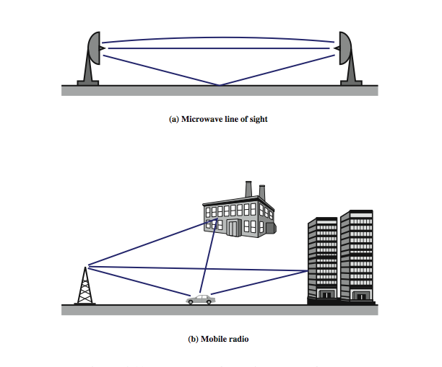
Multipath Interference
Notes:
Stallings DCC8e Figure 4.11 illustrates in general terms the types of multipath interference typical in terrestrial, fixed microwave and in mobile communications. For fixed microwave, in addition to the direct line of sight, the signal may follow a curved path through the atmosphere due to refraction and the signal may also reflect from the ground. For mobile communications, structures and topographic features provide reflection surfaces.

Slide 19
Summary
looked at data transmission issues
frequency, spectrum & bandwidth
analog vs digital signals
transmission impairments
Notes:
Stallings DCC8e Chapter 4 summary.

